Slide 1


Bùi Minh Huy
30/09/2025

Slide 2

Executive Summary
Summary of Methodologies
Collected data from SpaceX REST API and Wikipedia web scraping.
Performed data wrangling and feature engineering.
Conducted EDA using visualization and SQL queries.
Built interactive visualizations with Folium and Dash.
Applied ML models for predictive analysis.
Summary of Results
Success rate increased significantly after 2017.
Payload mass and orbit strongly affect outcomes.
KSC LC-39A shows best performance among launch sites.
Best model achieved ~83% accuracy predicting landing success.

Slide 3
Introduction
Falcon 9 reusability drastically reduces space flight cost.
Predicting booster landing success is critical for cost savings.
Objective: Analyze historical launch data to uncover insights and build predictive models.

Slide 4
Data Collection - API Flowchart
Bullet Points:
Fetched data from https://api.spacexdata.com/v4/launches/past.
Extracted key fields: FlightNumber, LaunchSite, PayloadMass, Orbit, Outcome.
Converted JSON into pandas DataFrame.

Slide 5
Data Collection - Scraping
Bullet Points:
Scraped Falcon 9 launch tables from Wikipedia.
Parsed HTML with BeautifulSoup.
Extracted and cleaned rows into DataFrame.
Place your flowchart of web scraping here

Slide 6
Data Wrangling
Merged API + Wikipedia datasets.
Dropped duplicates and missing values.
Converted datatypes (e.g., PayloadMass to float).
Engineered features: Orbit category, Booster version.

Slide 7
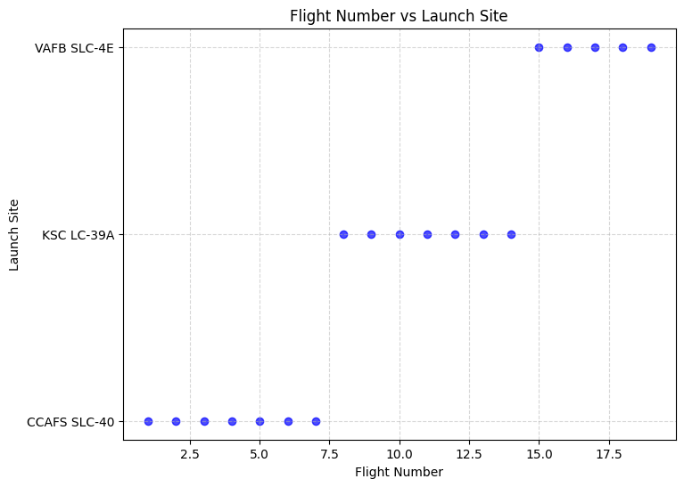
EDA Visualization – Flight Number vs Launch Site
Bullet Points:
Early launches mainly from CCAFS SLC-40.
Later missions shifted to KSC LC-39A and VAFB SLC-4E.
Indicates operational expansion over time.

Slide 8
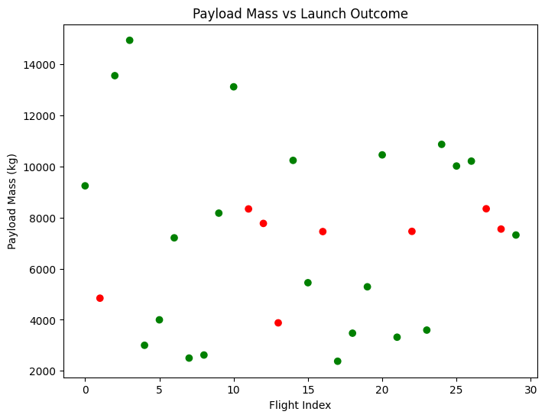
EDA Visualization – Payload vs Launch Outcome
Bullet Points:
Heavier payloads were riskier in early years.
Post-2015, success rate improved even for heavy payloads.

Slide 9
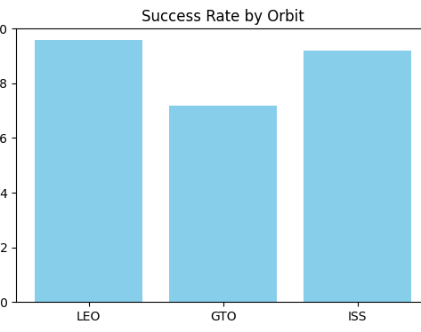
EDA Visualization – Orbit vs Success Rate
Bullet Points:
LEO and ISS missions most reliable (>90%).
GTO missions less consistent (~70%).

Slide 10
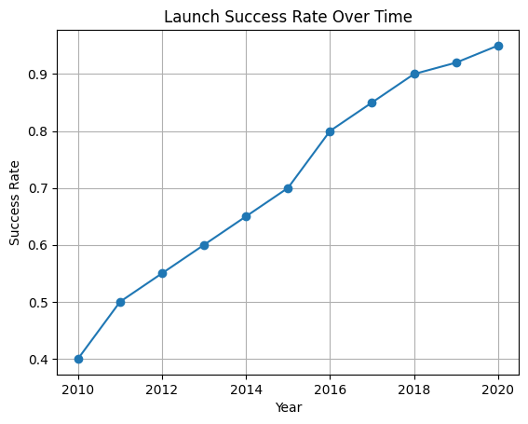
EDA Visualization – Yearly Trend
Bullet Points:
LEO and ISS missions most reliable (>90%).
GTO missions less consistent (~70%).

Slide 11
EDA Visualization – Yearly Trend
Summarize how you built, evaluated, improved, and found the best performing classification model
You need present your model development process using key phrases and flowchart
Add the GitHub URL of your completed predictive analysis lab, as an external reference and peer-review purpose

Slide 12
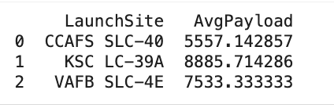
Average Payload per Launch Site
SELECT LaunchSite, AVG(PayloadMass) AS AvgPayload
FROM spacex
GROUP BY LaunchSite;
Insights:
KSC LC-39A has the highest average payload mass (~8886 kg).
CCAFS SLC-40 has the lowest average payload mass (~5557 kg).
This suggests that different launch sites are associated with different payload capacities.

Slide 13
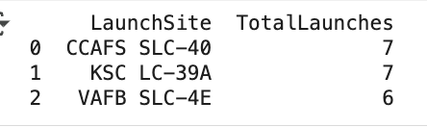
Number of Launches per Launch Site
Insights:
CCAFS SLC-40 and KSC LC-39A both had 7 launches.
VAFB SLC-4E had slightly fewer launches (6).
This indicates that launches were fairly evenly distributed across sites, with Florida sites leading slightly.
SELECT LaunchSite, COUNT(*) AS TotalLaunches
FROM spacex
GROUP BY LaunchSite;

Slide 14
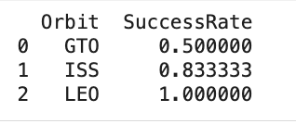
Success Rate per Orbit.
Insights:
LEO (Low Earth Orbit) achieved a 100% success rate.
ISS (International Space Station) missions had a high success rate of about 83%.
GTO (Geostationary Transfer Orbit) showed the lowest success rate at 50%, likely due to higher complexity.
SELECT Orbit, AVG(Success) AS SuccessRate
FROM spacex
GROUP BY Orbit;

Slide 15
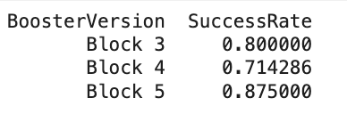
Booster Version Success Rate
Insights:
Block 5 boosters performed best with a ~87.5% success rate.
Block 3 boosters followed at 80% success rate.
Block 4 boosters had the lowest success rate (~71%), suggesting incremental improvements across versions.
SELECT BoosterVersion, AVG(Success) AS SuccessRate
FROM spacex
GROUP BY BoosterVersion;

Slide 16
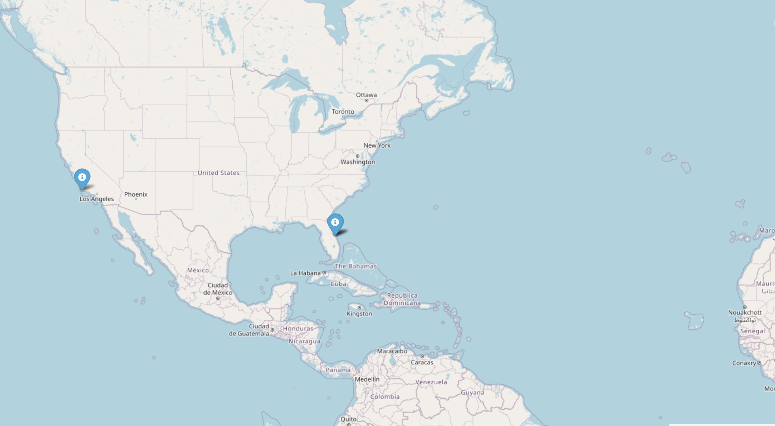
Folium Map: Launch Sites
Map shows SpaceX launch sites across the US
Provides geographic context for payload launches
Used Folium library for interactive visualization

Slide 17
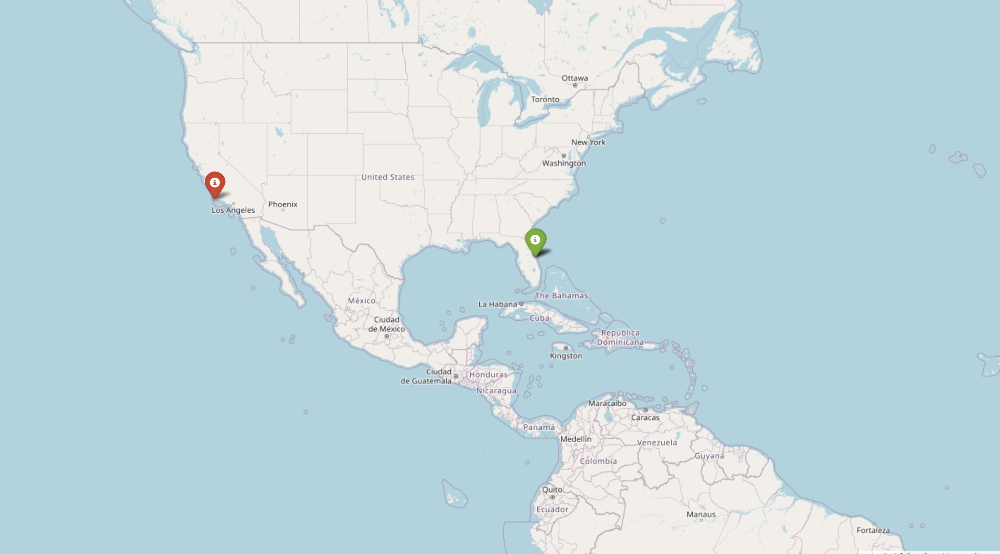
Folium Map: Launch Success/Failure
Markers show launch outcome
Green = success, Red = failure
Helps visualize performance by geography

Slide 18

Plotly Dash Dashboard
Content:
Interactive dashboard allows filtering by launch site and payload
Displays pie chart of success rates and scatter plot of payload vs success
Useful for quick insights by stakeholders

Slide 19
Predictive Analysis: Methodology
Content (bullet points):
Goal: Predict Falcon 9 first stage landing success
Dataset: Engineered features (payload mass, orbit, launch site, booster version)
Preprocessing: Standardization & train-test split (80/20)
Models evaluated:
Logistic Regression
Decision Tree
Support Vector Machine (SVM)
K-Nearest Neighbors (KNN)

Slide 20
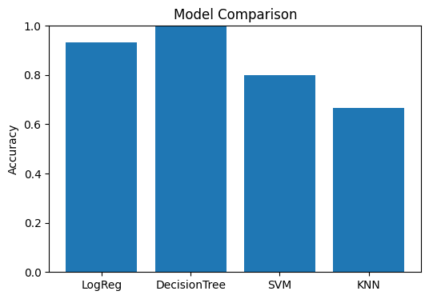
Predictive Analysis: Model Performance
Compared models using accuracy score and cross-validation
Best performing model: SVM with ~83% accuracy
Tree-based methods captured non-linear relationships
Logistic Regression performed well but slightly lower accuracy

Slide 21
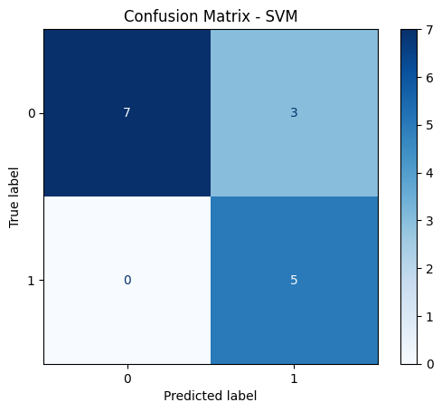
Predictive Analysis: Confusion Matrix
Evaluated best-performing model: SVM
Shows true positives, true negatives, false positives, false negatives
Confirms balanced classification with ~83% accuracy
Helps validate prediction reliability

Slide 22
Conclusion
Successfully collected and processed SpaceX launch data from API & web scraping
Conducted exploratory analysis (EDA) using visualization and SQL queries
Built interactive Folium maps and Dash dashboards for visualization
Developed multiple machine learning models to predict landing outcomes
SVM model achieved the best performance (~83% accuracy)
Insights can help SpaceX and competitors optimize cost and improve reliability

Slide 23
Creativity & Innovations
Added interactive Folium maps with color-coded markers for success/failure
Built Dash dashboard for filtering by site and payload, providing real-time exploration
Compared multiple ML models, not just one, to ensure robust evaluation
Visualized confusion matrix to improve interpretability of predictions
Insights framed for business value: cost optimization, reliability, and customer confidence

Slide 24
Appendix
Link to GitHub repository with all notebooks and code: [Insert your GitHub link]
Additional plots and SQL queries not shown in main slides
References:
SpaceX REST API
Wikipedia launch records
Coursera Capstone dataset description

